Slide 1

Shopify
A Website Builder

Slide 2
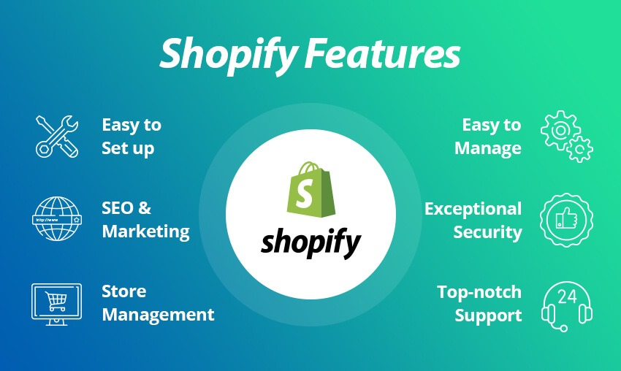

Slide 3
About Shopify
It's a platform specifically designed for creating online stores and selling products or services.
Shopify offers a user-friendly interface, customizable templates, and a wide range of features tailored for e-commerce businesses.
With Shopify, users can easily set up their online store, manage inventory, process orders, accept payments, and more.
It's one of the leading platforms in the e-commerce industry and is trusted by businesses of all sizes, from small startups to large enterprises.

Slide 4
We have of couple of options to create an account through shopify
An Online Store
The Online Store channel is a core feature of Shopify that allows merchants to create and customize their own online storefronts.
Through this channel, users can design their website, manage products and inventory, process orders, and more.

Slide 5
In person
Process sales using various payment methods including credit cards, cash, and mobile payments.
Manage inventory by tracking stock levels and adding products.
Customize receipts and email them to customers.
Apply discounts and promotions.
View sales reports and analytics.

Slide 6
An Existing websight or Blog
Navigate to Online Store
Choose Themes
Select a Theme
Customize Your Theme
Add Pages
Import Content
Customize Blog Settings
Preview and Publish
Manage Content

Slide 7
Social media
Social media Integration
Social Media Sharing
Social Media Login
Social Media Advertising
Social Proof and Reviews
Social Media Analytics

Slide 8
Online marketplaces
Platform Setup:
Merchant Registration:
Seller Profiles:
Product Listings:
Order Management:
Commission Structure:
Customer Experience:
Platform Administration:

Slide 9
What do you plan to sell first
Products I buy or made myself
Dropshipping Products
Print-on-demand-products
Digital products
Services

Slide 10
Thank You

